Slide 1
Neuromorphic Hardware
Department of CSE
Kongu Engineering College
Eraja Ganapathy M (18CSR040)
Divya E (18CSR039)

Slide 2
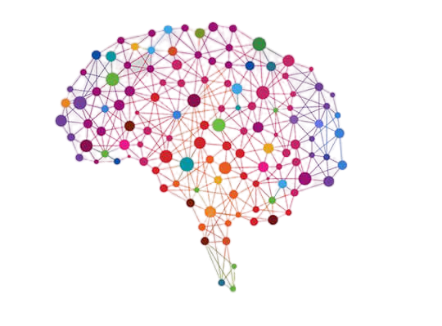
Neuromorphic engineering, also known as neuromorphic computing started as a concept developed by Carver Mead in the late 1980s, describing the use of very-large-scale integration (VLSI) systems containing electronic analogue circuits to mimic neurobiological architectures present in the nervous system."
- Easton, 2015

Slide 3

Things we learn from this Presentations
Neuromorphic Chips
Existing Applications
Benefits
Future Applications
Negative Effects

Slide 4
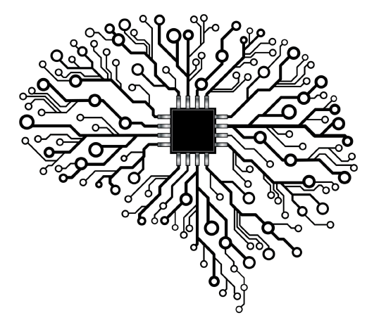
Neuromorphic Chips
Modeled on biological brains—designed to process sensory data such as images and sound and respond to changes in that data in ways not specifically programmed.

Slide 5
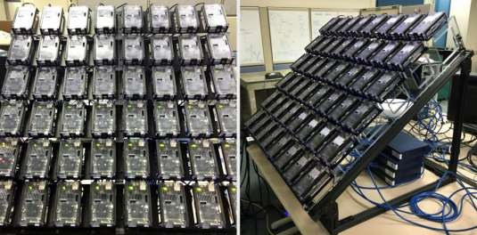
Existing Applications
IBM TrueNorth - most advanced neuromorphic (brain-like) computer chip to date
Qualcomm's Zeroth Program
Human Brain Project in Europe
Nvidia's Tegra X1 revealed at CES 2015

Slide 6
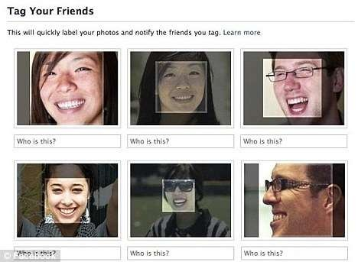


Existing Applications

Slide 7
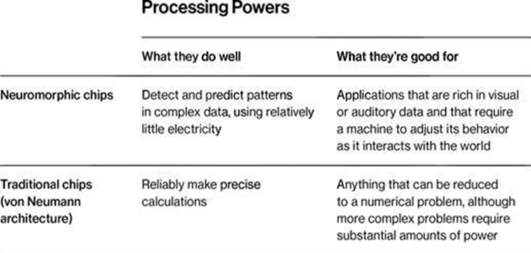

Slide 8
Advantages
Can compute in real time, which is similar to how the brain works
Might take us a step closer to artificial intelligence
Different applications in various disciplines
Advances in neuroscience and chip making

Slide 9

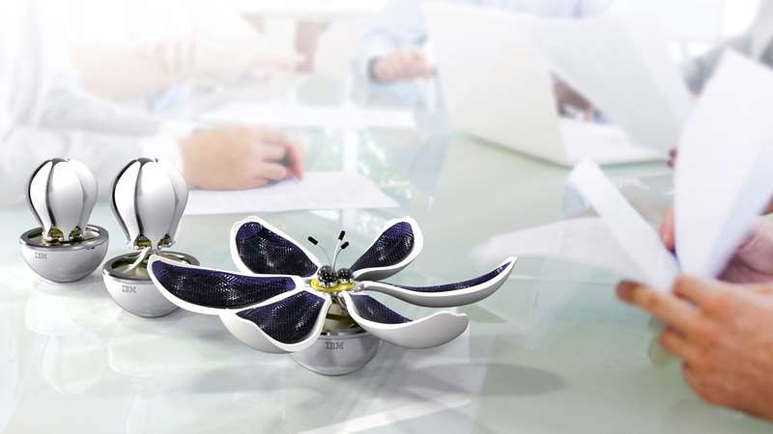
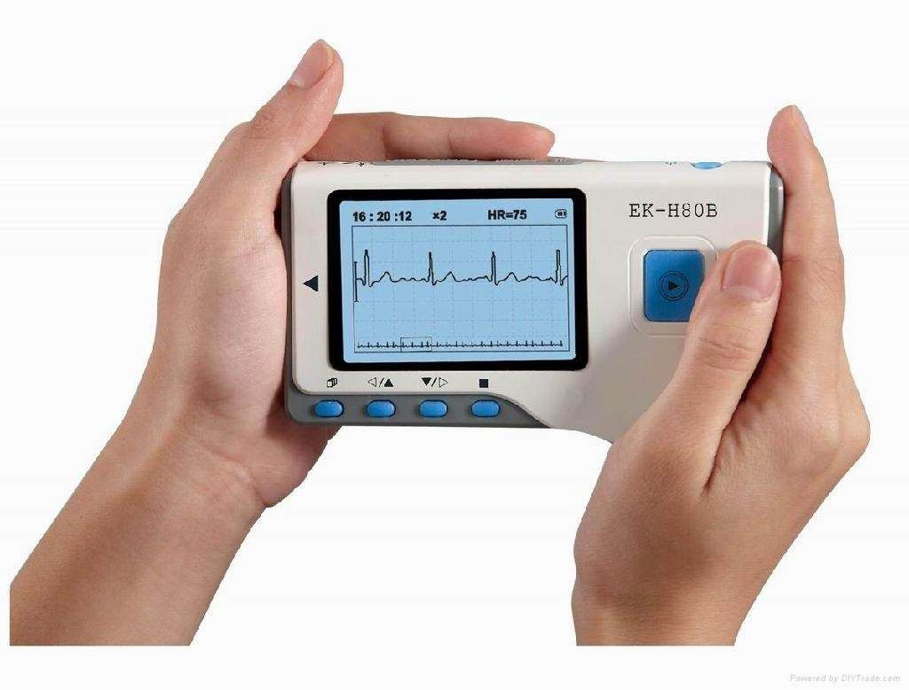
Future Applications
Roller Bot
Sensor Flower
Auto-ECG

Slide 10


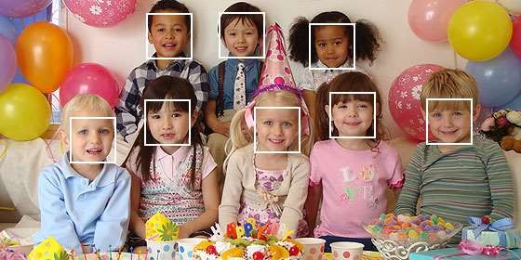
Transforming Mobile
Place your screenshot here
Thermometers That Can Smell
Attendance In A Snap

Slide 11
Negative Effects / Limitations
High cost
Still a bit far in terms of real-life applications
Needs more research
Further development paves way for AI, causing ethical concerns

Slide 12
Thanks!
Any questions?

